Slide 1
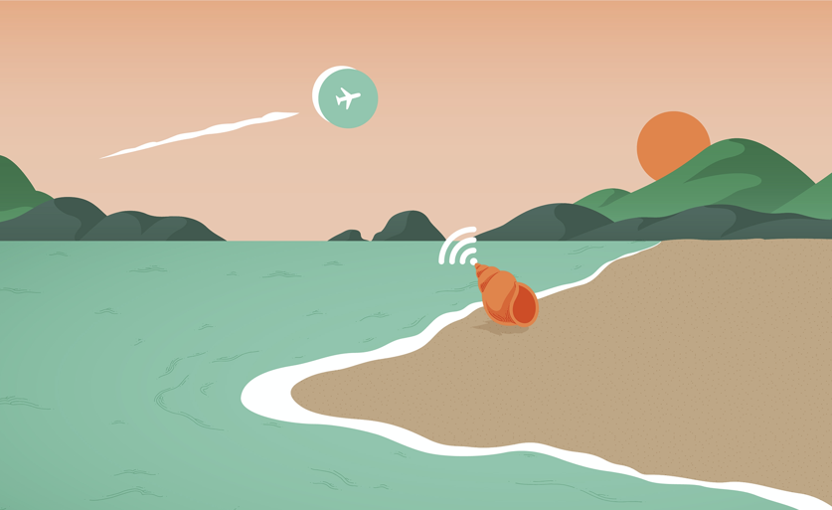

TELEFONES ESPERTOS, HÁBITOS INTELIGENTES

Slide 2

HOJE NÓS VAMOS...
Discutir como se formam os hábitos
Mergulhar fundo nas maneiras com que nossos telefones são programados para atrair nossa atenção
Aprender a estabelecer limites com os nossos telefones
Ver como podemos ser mais espertos do que os nossos smartphones

Slide 3
REGRAS BÁSICAS
Silêncio quando não estiver falando
Dê dicas visuais
Faça perguntas e compartilhe ideias
Divirta-se

Slide 4

AQUECIMENTO
Diga seu nome
Conte-nos de um bom hábito que formou recentemente
OI, EU SOU AYA.
ME MANTENHO HIDRATADA !

Slide 5
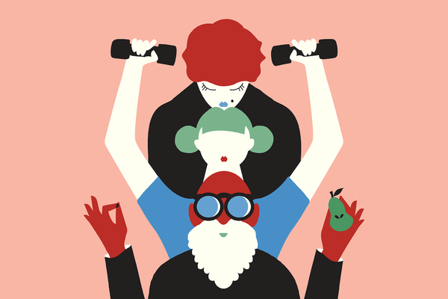
COMO FORMAMOS BONS HÁBITOS?
Illustration by Amrita Marino

Slide 6
PARTE 1:
PRINCÍPIOS NORTEADORES

Slide 7

1.
Fazer pequenas alterações graduais que funcionem para você
Illustration by Wenting Li

Slide 8
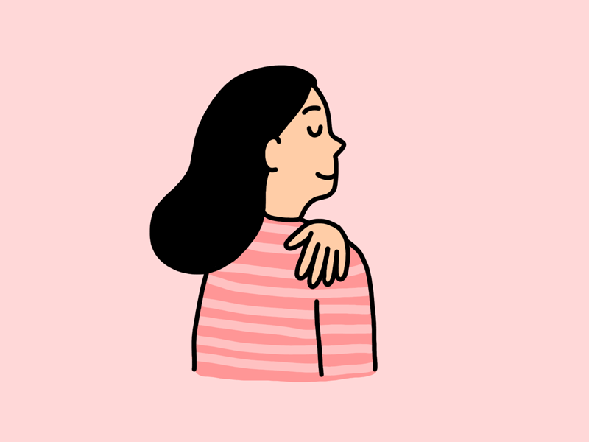
2.
Reconhecer os progressos!
Illustration by Ashleigh Green

Slide 9

3.
Alcançar um equilíbrio realista.
Illustration by Radio

Slide 10
Coisas favoritas sobre os nossos telefones
Coisas menos favoritas sobre os nossos telefones

Slide 11
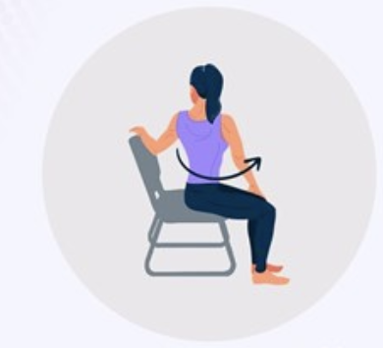
MICRO-PAUSA

Slide 12
PARTE 2:
TECNOLOGIA QUE NOS MANTÉM VICIADOS

Slide 13
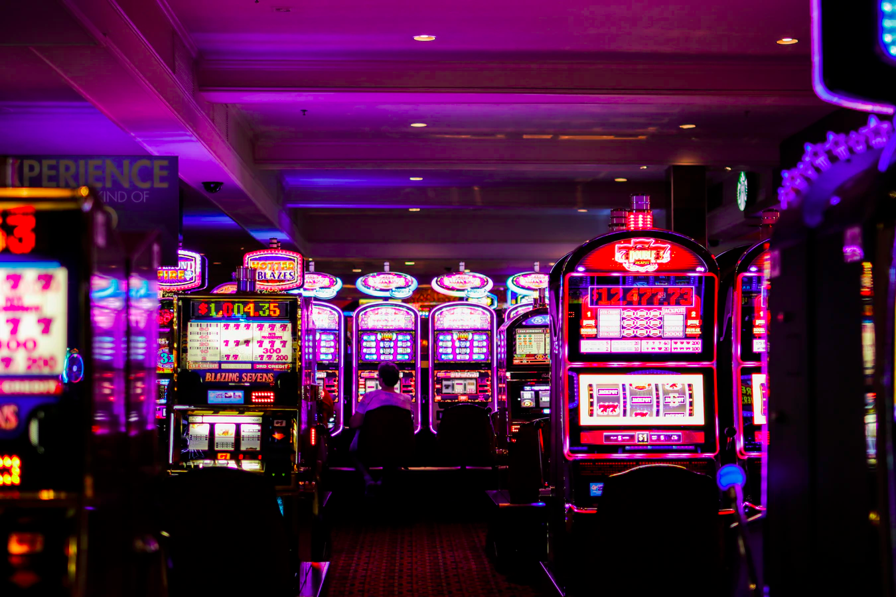
Photo credit: Benoit Dare on Unsplash
Notes:
Slot machines, casinos
You may have heard that the design of digital technologies, particularly social media platforms like Facebook and Instagram, likened to slot machines in casinos.
Like casino slot machines, these technologies are designed to be totally immersive so that one loses their sense of self awareness, conscious decision making and is actually carried along by the machine, chasing gratification.
This is particularly relevant for young people, who are drawn to peer recognition, belonging and acceptance.
These immersive and mesmerizing spaces dominate their social environment, and can create a feeling of performance.
At worst, ‘switching off’ from technology creates feelings that could be associated with clinically diagnosed addictions - feelings of cravings, depression, anxiety, frustration, confusion and isolation.

Slide 14

Notes:
Facebook like button
Social media good place to start...
The Facebook Like was launched in 2009 and it quickly became a potent data-collection tool revealing a lot about the users who used it.
Facebook started in 2003 as "Facemash" a college networking site were college students could compare photos to choose the more attractive person. (it’s worth noting that the Facebook’s founder and early designers were themselves adolescents and young adults)
By the time the Like button was introduced in 2009, FB had 600 million users and was the most popular social networking site worldwide
From this early innovation we can see how one small design feature can be momentous in collecting data...
A 2013 study revealed that Facebook “likes” could include deeply personal and sometimes private attributes about a person including: sexual orientation, ethnicity, religious and political views, personality traits, intelligence, happiness, use of addictive substances, parental separation, age, and gender.’
It’s worth noting that this study was written in part by David Stillwell the director of Cambridge Psychometrics Centre, who had made the my Personality Facebook application, a kind of personality test for Facebook users that later became the model and the basis for Cambridge Analytica’s political micro targeting. And this study talks about these invasive tools as being good for “marketing” and “user interface design

Slide 15
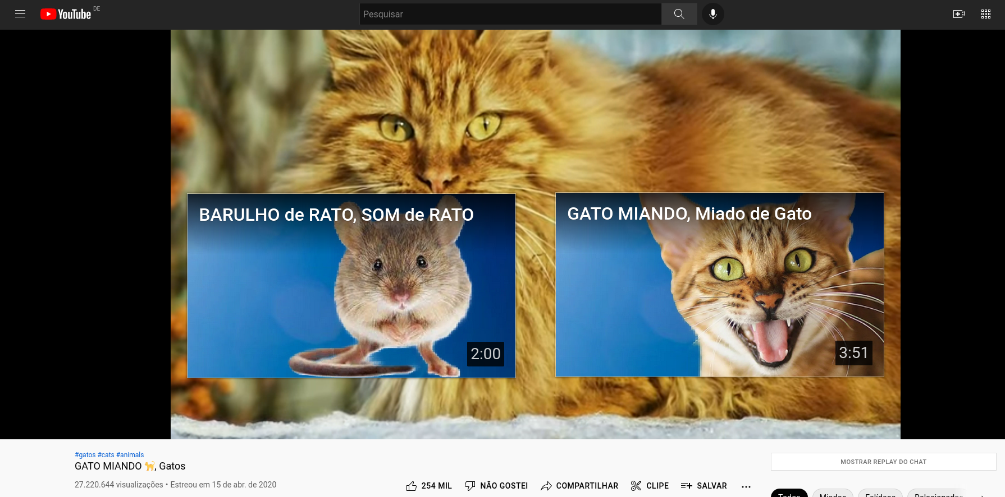
Notes:
Slippery technology – nudging and poking
By the time Facebook bought Instagram in 2012, this behavioral data collection was already established and advanced.
They also, crucially bought this service onto mobile devices, into people’s pockets and specifically into young people’s pockets.
These platforms are built on dopamine-driven feedback loops
It is not just the actions you take, what you like, what you comment on, what you share, it’s also all the things that can be inferred from these actions, and even things that can be inferred from things that you don’t do
And crucially the ‘like’ button, and everything that it represents is particularly enticing and mesmerizing for young people.

Slide 16
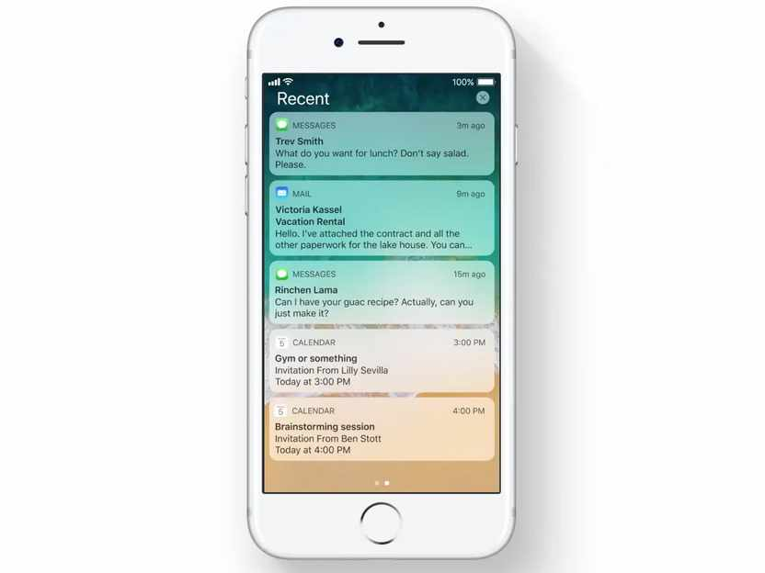
crédito da foto: Steven John do Business Insider
Notes:
Slippery technology – nudging and poking
By the time Facebook bought Instagram in 2012, this behavioral data collection was already established and advanced.
They also, crucially bought this service onto mobile devices, into people’s pockets and specifically into young people’s pockets.
These platforms are built on dopamine-driven feedback loops
It is not just the actions you take, what you like, what you comment on, what you share, it’s also all the things that can be inferred from these actions, and even things that can be inferred from things that you don’t do
And crucially the ‘like’ button, and everything that it represents is particularly enticing and mesmerizing for young people.

Slide 17
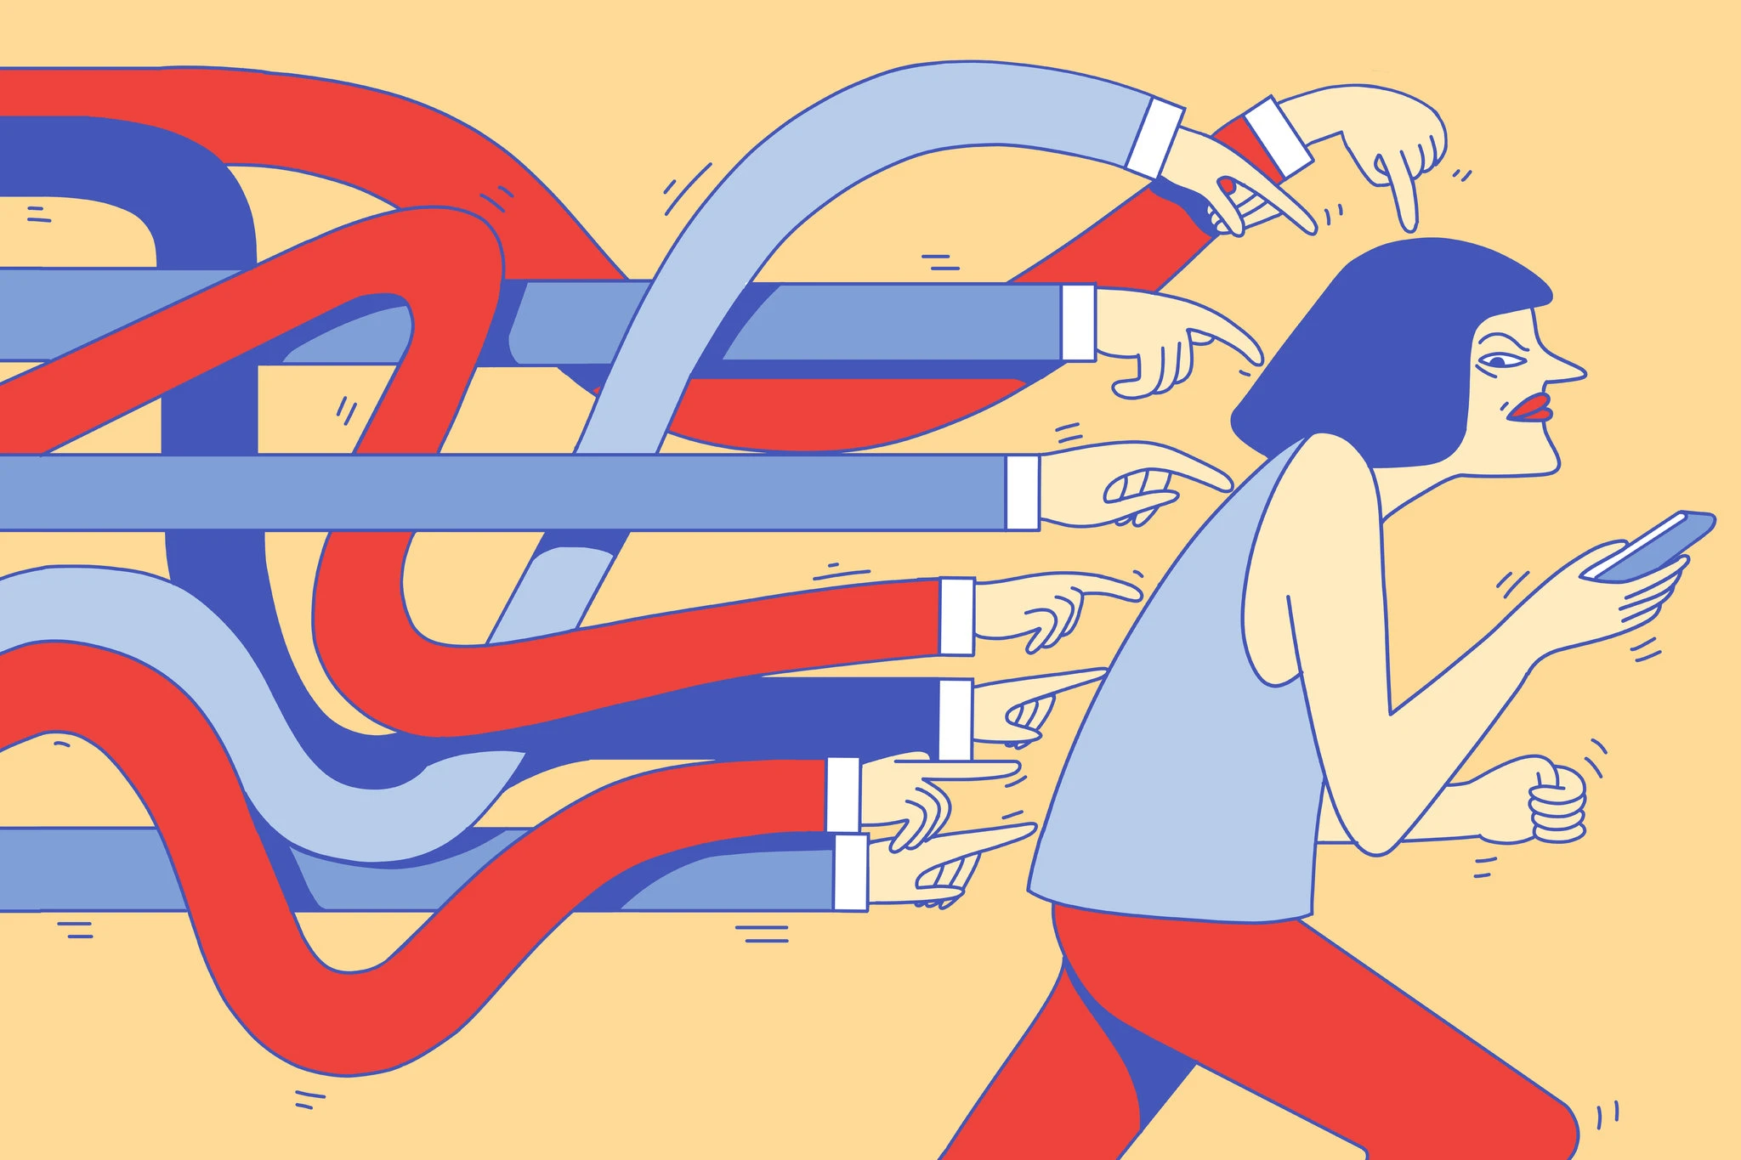
Ilustração de Elena Xausa
Notes:
Slippery technology – nudging and poking
By the time Facebook bought Instagram in 2012, this behavioral data collection was already established and advanced.
They also, crucially bought this service onto mobile devices, into people’s pockets and specifically into young people’s pockets.
These platforms are built on dopamine-driven feedback loops
It is not just the actions you take, what you like, what you comment on, what you share, it’s also all the things that can be inferred from these actions, and even things that can be inferred from things that you don’t do
And crucially the ‘like’ button, and everything that it represents is particularly enticing and mesmerizing for young people.

Slide 18
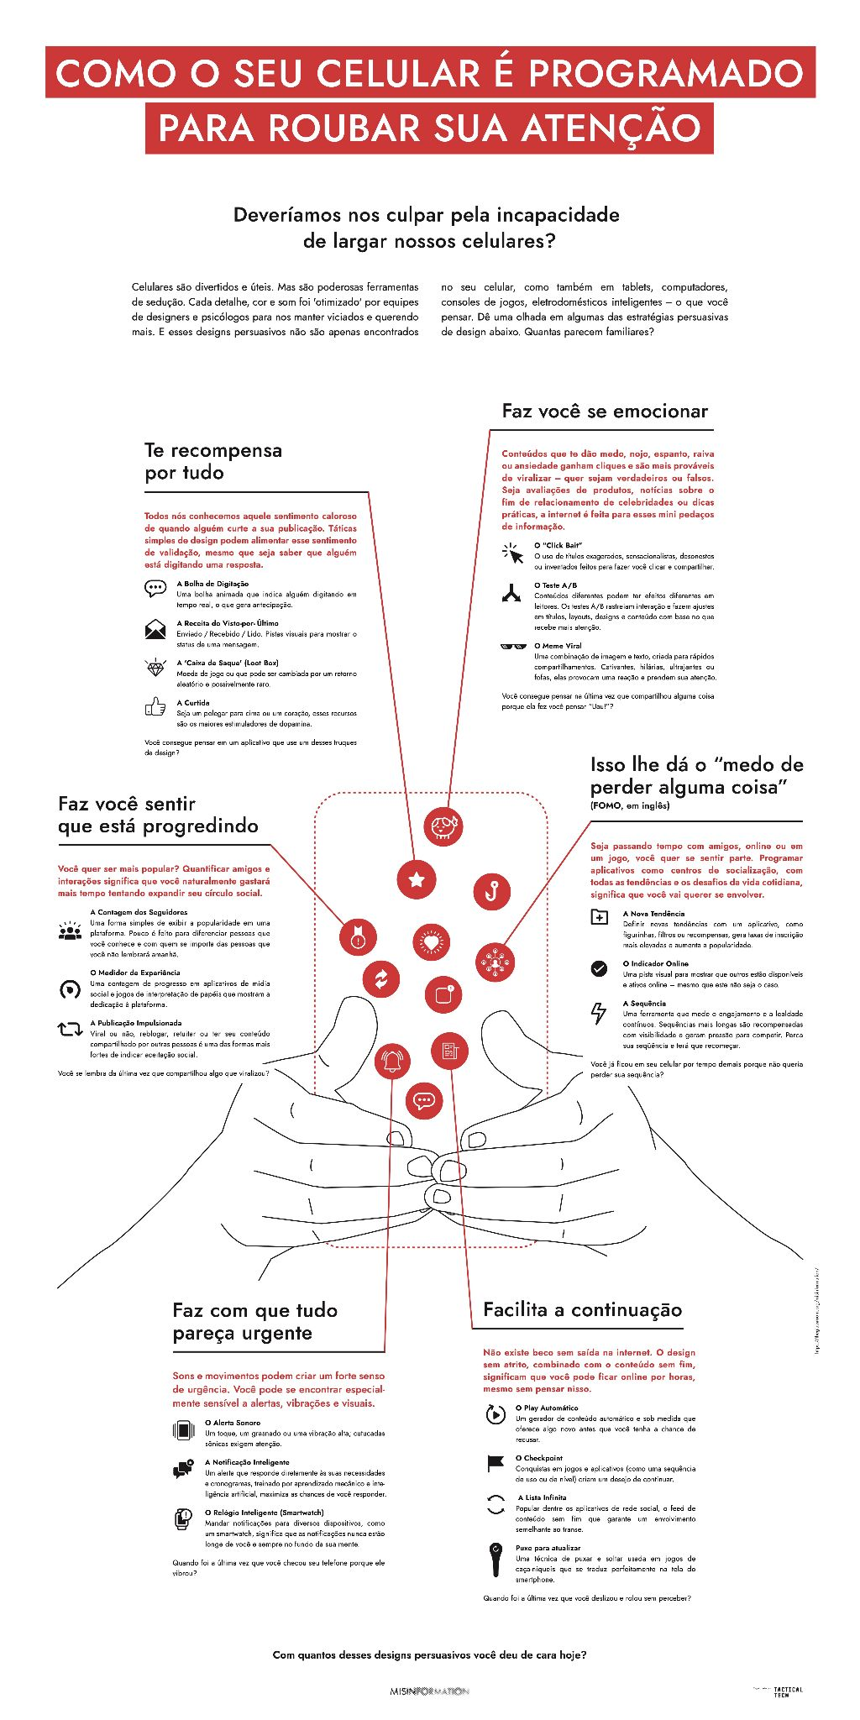
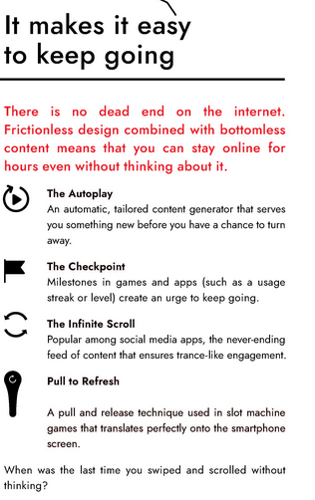
Facilita a continuação
www.theglassroom.org

Slide 19
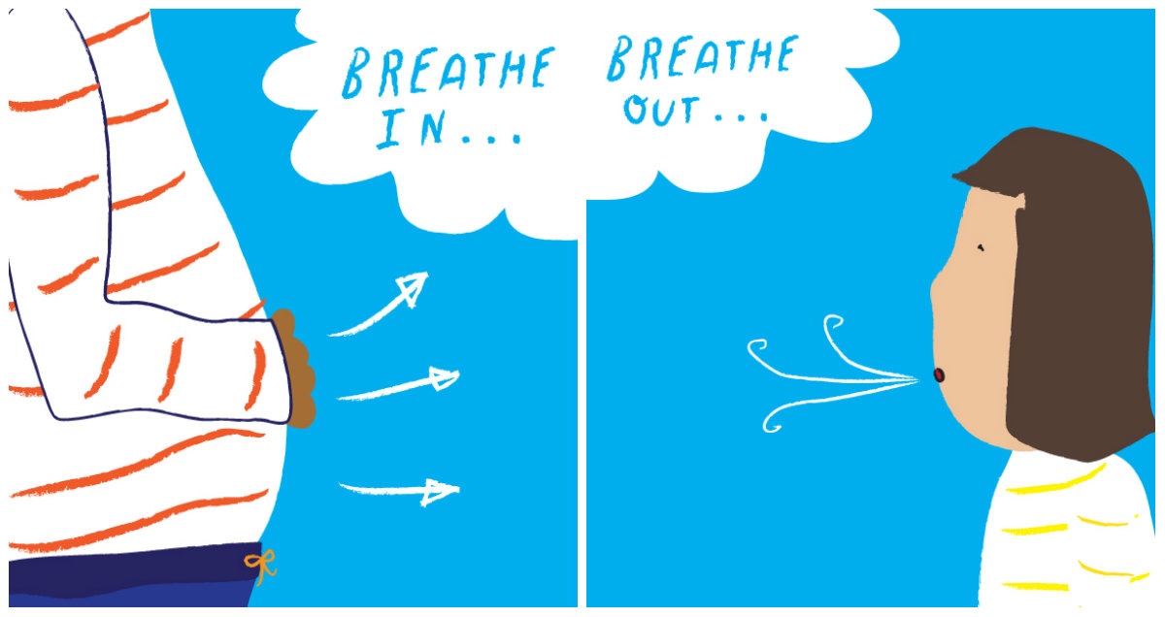
MICRO-PAUSA
inspire… expire…
Source: www.pbs.org

Slide 20
PARTE 3:
VAMOS CONVERSAR

Slide 21
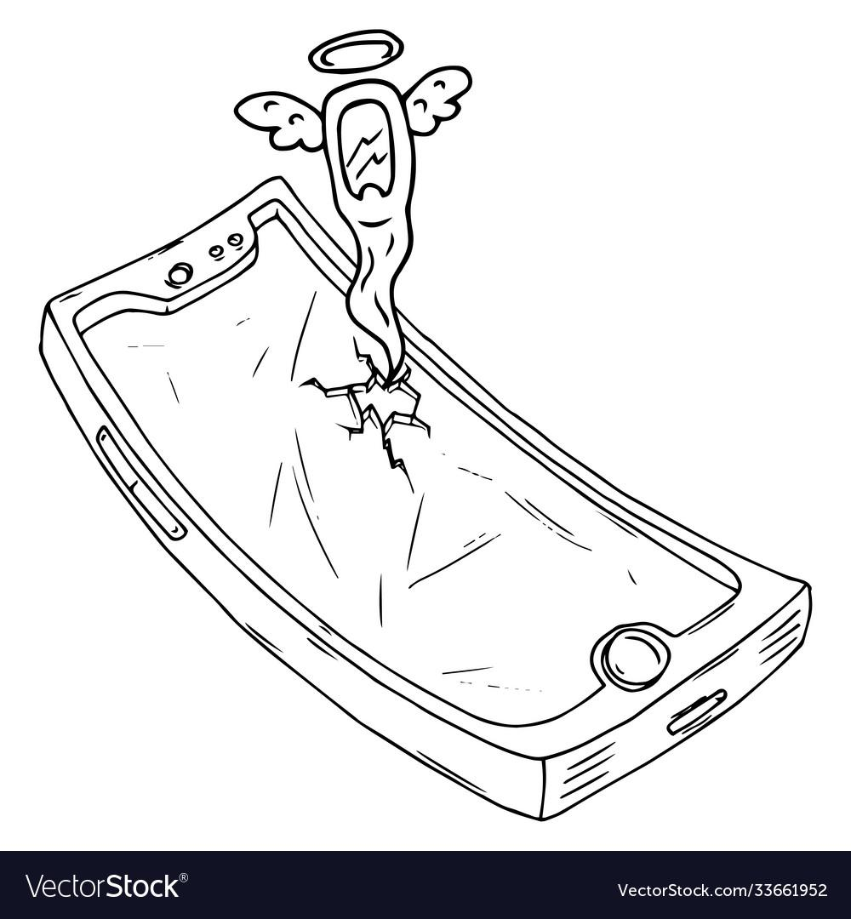
IMAGINE...
Há uma tempestade extrema que destrói o complexo sistema de cabos subterrâneos. Isto provoca o colapso da Internet em toda a sua cidade durante um mês inteiro!
Como é a vida cotidiana ao fim desse mês?

Slide 22
IMAGINE ...
Há uma tempestade extrema que destrói o complexo sistema de cabos subterrâneos. Isto provoca o colapso da Internet em toda a sua cidade durante um mês inteiro!
Como é a vida cotidiana no final desse mês?
Groupo 1 - interações sociais
Groupo 2 - entretenimento
Groupo 3 - trabalho
Sala de Discussão por 10 minutos
Escolha um para anotar e outro para apresentar
Apresente o que o seu grupo encontrou (2 minutos)

Slide 23
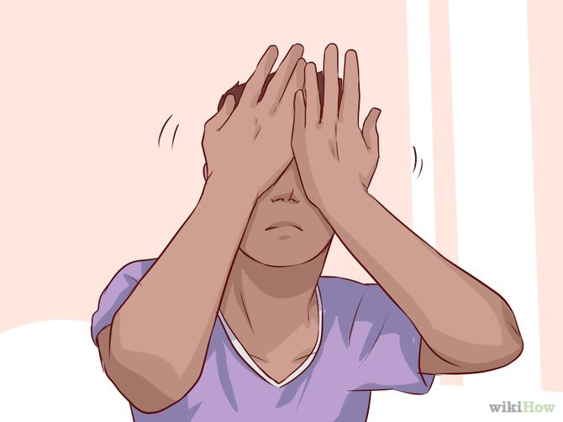
MICRO-PAUSA
Source: Wiki How

Slide 24
ALGUÉM TEM ALGUMA DICA DE COMO FICA DE OLHO NA TECNOLOGIA?

Slide 25
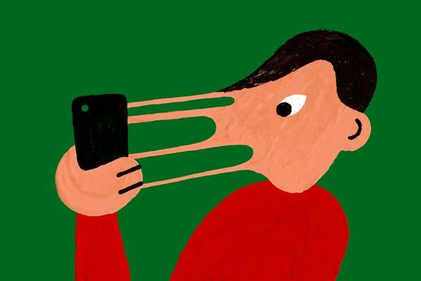
PASSOS PRÁTICOS
inspirado no artigo do the New York Times, Como terminar o namoro seu telefone, por Catherine Price

Slide 26

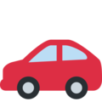
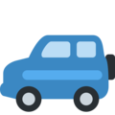
1.
Criar lombadas de velocidade.

Slide 27
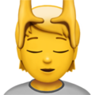


2.
Preste atenção ao seu corpo.

Slide 28



3.
Faça um jogo!
Quando vir alguém em um telefone, lembre-se da sua intenção.

Slide 29

ABRACE A SI MESMO!

Slide 30
APRENDIZADOS...
Os hábitos são formados e reforçados de várias maneiras
Os telefones são projetados para captar a sua atenção
Estabeleça limites com o seu telefone que funcionem para você

Slide 31
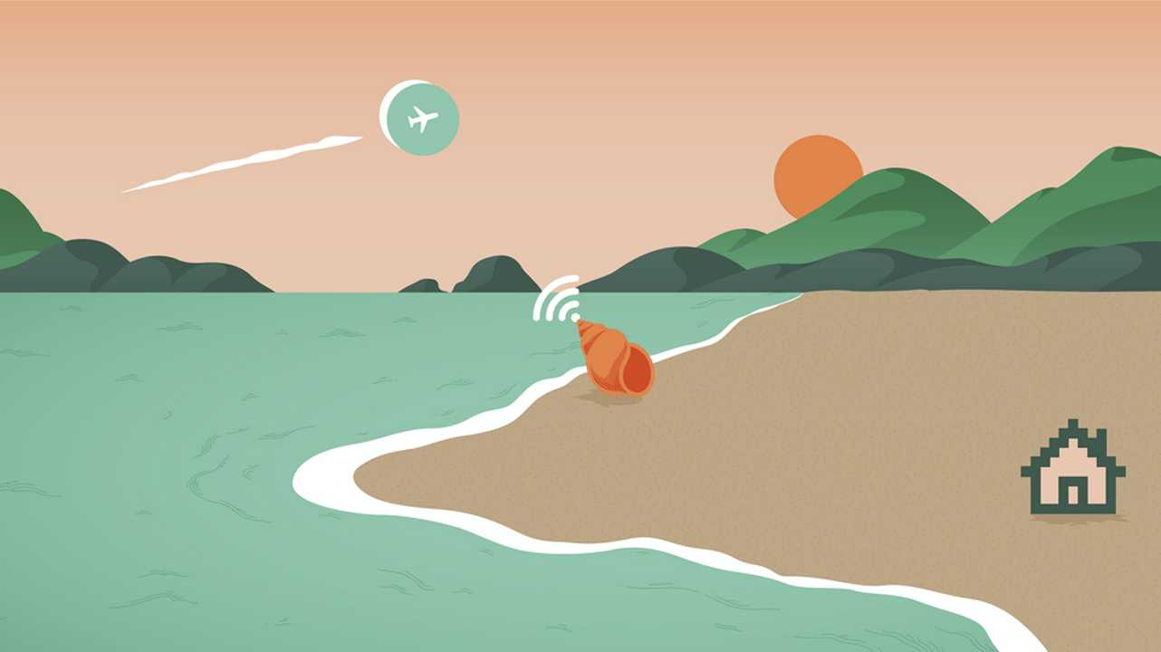
OBRIGADO!

